Slide 1
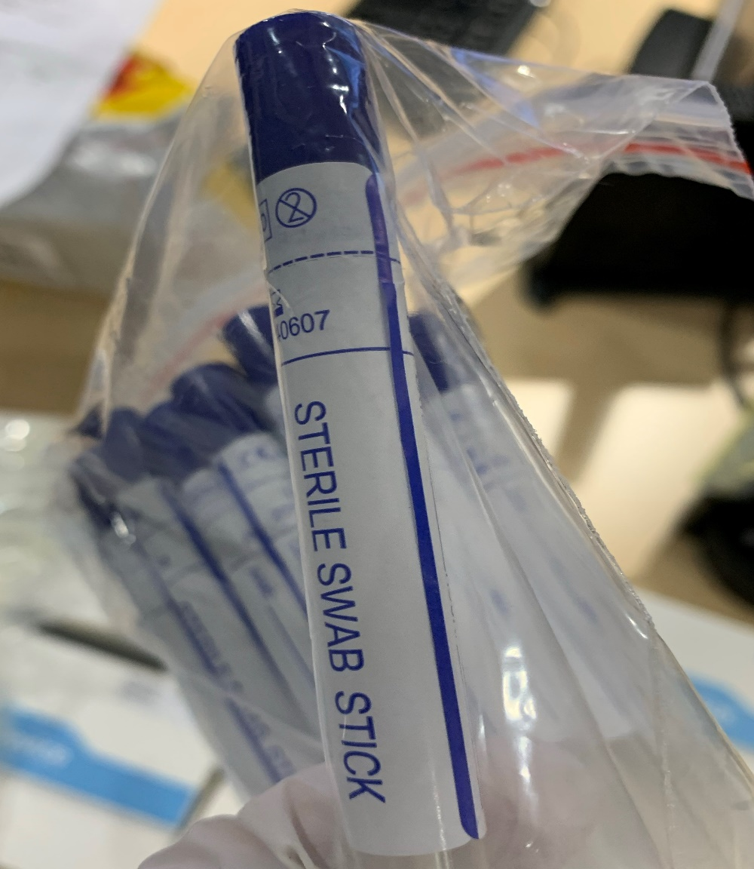
Outcomes of the urgent global Operation “STOP”
26th Conference of the Directors General of Customs of the WCO West and Central Africa region
(28 and 29 April 2021)

Slide 2
Contents
STOP: timely emergency response at short notice
STOP: making the world safer and saving lives
COVID-19 and agility shown by Customs
Way forward

Slide 3
I- STOP: timely emergency response at short notice
1.1 Participants
WCO Secretariat
99 WCO Members and the RILOs
International organizations: UNODC-INTERPOL-Europol-OLAF
Private sector: Novartis-Servier-Pfizer-Sanofi-UL

Slide 4
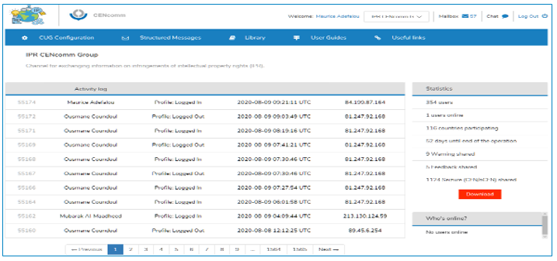
I- STOP: timely emergency response at short notice
1.2 Operational details
Scope Risk indicators Secure tool
Medicines
Medical supplies (sanitizer gels)
C-19 test kits
Masks
Goggles
Thermometers
Etc.
WCO COVID-19 checklist
UNODC module
Newsletters
Novartis notes on hydroxychloroquine, azithromycin and dexamethasone
IPR CENcomm Group

Slide 5
II- STOP: making the world safer and saving lives
2.1 Outcomes
STOP: useful barometer of illicit trafficking linked to COVID-19
1,233 cases out of a total of 1,683 seizures and detentions reported by 51 Members
307,215,524 units of illicit medicines seized/detained
47,891,628 units of medical supplies (masks, gloves, test kits, thermometers) seized/detained, as well as 2,762,389 litres of sanitizer gel

Slide 6
II- STOP: making the world safer and saving lives
2.1 Outcomes
Breakdown of the 1,233 cases by WCO region

Slide 7
II- STOP: making the world safer and saving lives
Member | Number of cases
Togo | 62
Nigeria | 43
Benin | 29
Cameroon | 22
Mali | 15
Senegal | 10
Niger | 5
Guinea | 4
Central African Republic | 4
Liberia | 1
Total | 195
Distribution of cases by Member in the West and Central Africa region

Slide 8
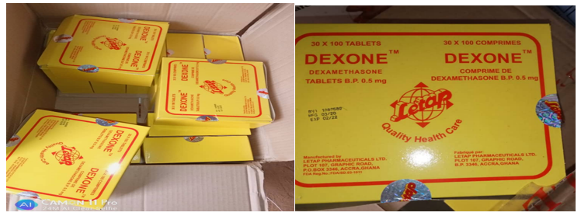
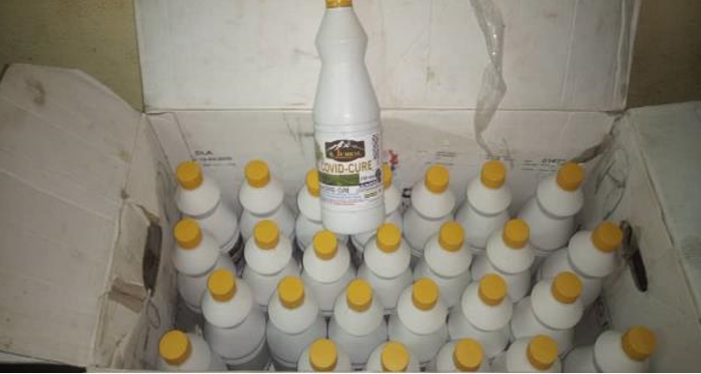
II- STOP: making the world safer and saving lives
Threat from illicit medicines
1,716,000 dexamethasone tablets seized by Niger Customs
“COVID-CURE” medicine, purported to cure COVID-19, seized by Cameroon Customs

Slide 9
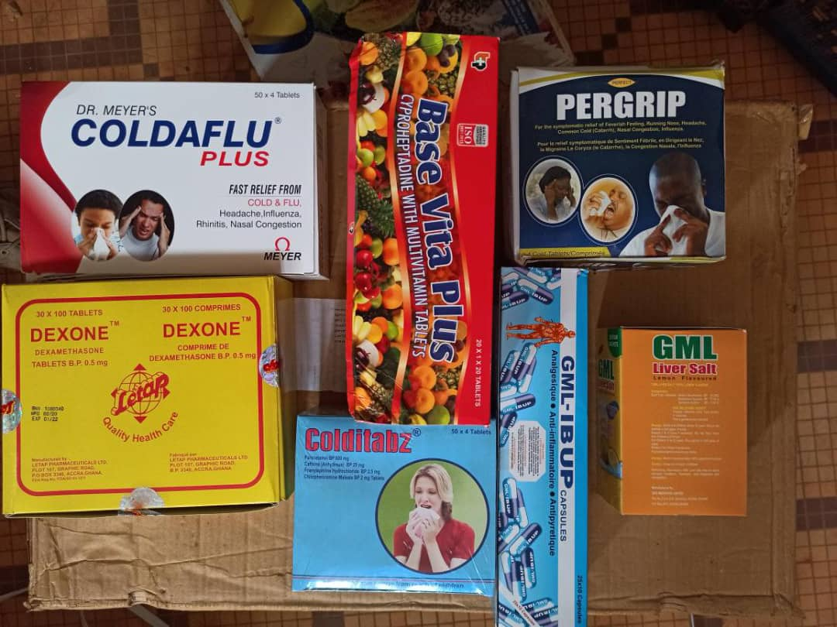
II- STOP: making the world safer and saving lives
Threat from illicit medicines
307,215,524 units of illicit medicines seized/detained
Region-by-region analysis of seizures/detentions of medicines reveals that 99.45% of them come from the West and Central Africa region.

Slide 10
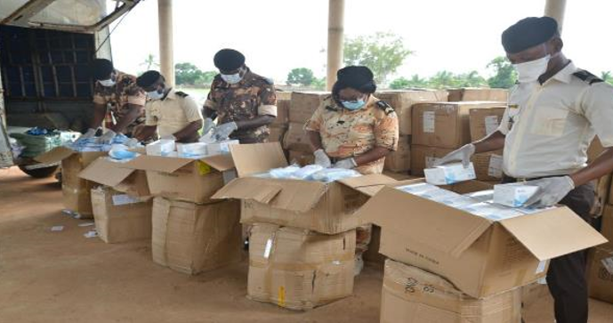
II- STOP: making the world safer and saving lives
medical supplies
A large batch of face masks seized by Benin Customs during Operation STOP

Slide 11
II- STOP: making the world safer and saving lives
2.3 Small parcels remain a challenge

Slide 12
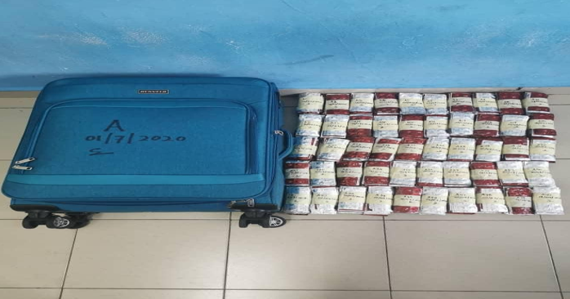
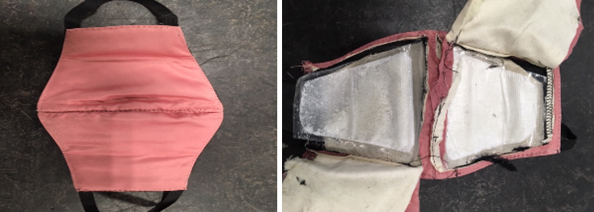
II- STOP: making the world safer and saving lives
2.3 Small parcels remain a challenge
4,003 items of miscellaneous medicines seized in a postal package in Skopje
0.35 kg of cocaine hidden in protective masks seized by United Kingdom Customs

Slide 13
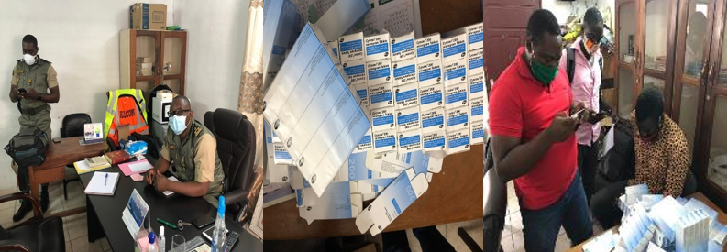
III- COVID-19 and agility shown by Customs
3.1 Best practices
Inter-agency collaboration
Collaboration with the private sector
Intelligence sharing

Slide 14
III- COVID-19 and agility shown by Customs
Case studies
1,008 capsules of unapproved medicine against the coronavirus labelled “Lianhua Qingwen Jiaonang” seized at the post office in Dakar Airport by Senegalese Customs

Slide 15
III- COVID-19 and agility shown by Customs
Tramadol issues:
150,000 items of tramadol carefully hidden in bags and undeclared, seized at Murtala Muhammed Airport in Lagos by the Nigeria Customs Service

Slide 16
IV- Way forward: lessons learned/difficulties
Lessons learned from Operation STOP:
a real-world test for Customs
WCO and its Members agility
Difficulties:
IPRCENcomm
Investigations

Slide 17
Funded by Japan (142 Members, Interpol, Olaf, UNODC, WHO, Europol)
Raising awareness webinar with COVID-19 pharmaceutical companies
IPRCENcomm improvement: pre-arrival template/Right holder corners, mobile version
4 Regional WS for the participants

Slide 18
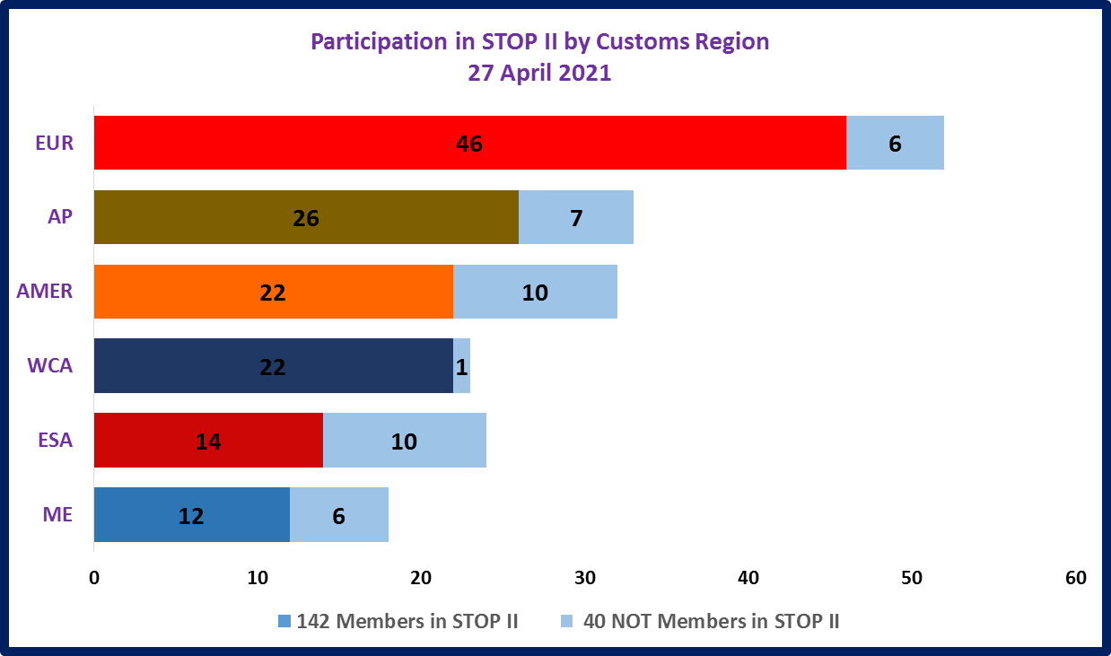

Slide 19
STOP II OPERATION LAUNCH EVENT
30 April 2021, 1pm to 2 pm Brussels time
Time frame | Item | Responsible
12:45 -12:55 | Connexion and technical arrangement | WCO
13:00 -13:10 | Opening remarks | Stefan Kirsch, Deputy Director, Compliance WCO
13:10 -13:20 | Official launch speech for Operation STOP II | Dr Kunio Mikuriya, Secretary General, WCO
13:20-13:30 | Chair Council address: a strong commitment for the Members involvement in STOP II | Ahmed Al Khalifa, WCO Council Chairperson
13:30-13:50 | Open discussion | All participants
13:50-14:00 | Closing remark | Pranab Daas, Director Facilitation and Control, WCO

Slide 20
Thank you for listening
Stop@wcoomd.org
Maurice Emiola ADEFALOU
Technical Officer
IPR, Health and Safety Programme manager
Maurice.adefalou@wcoomd.org

